Slide 1
Portland - Limestone Blended Cement
Karl Zipf
DelDOT - 2014

Slide 2
The following is an edited presentation from the
Portland Cement Association
This is not an endorsement for the PCA
DelDOT does not have any test data to verify their claims.

Slide 3
Portland-Limestone Blended Cements

Slide 4
Portland-Limestone Cement
What is a PLC?
  Type IL blended cement in ASTM C595/AASHTO M240
    5% to 15% limestone by mass
    Ternary cements
Why the proposal?
  Option to implement proven technology to obtain desired performance and improve sustainability of concrete

Slide 5
Environmental Benefits
Increases plant capacity
Reduces carbon footprint
Saves energy

Slide 6
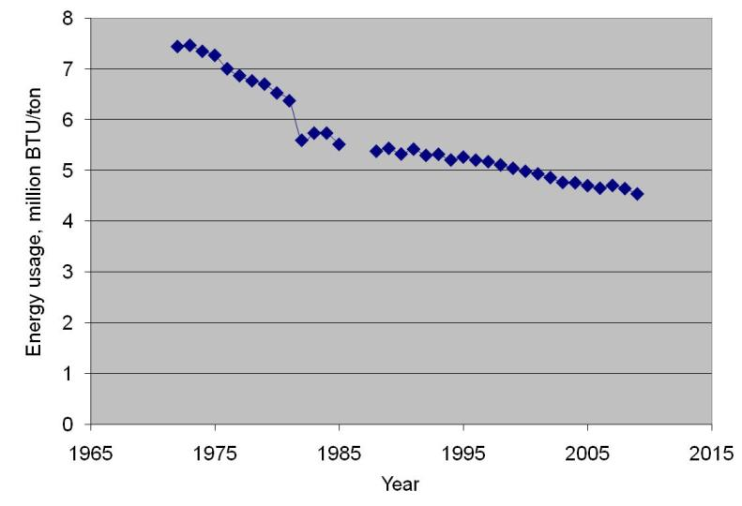
Energy to Produce Cement

Slide 7
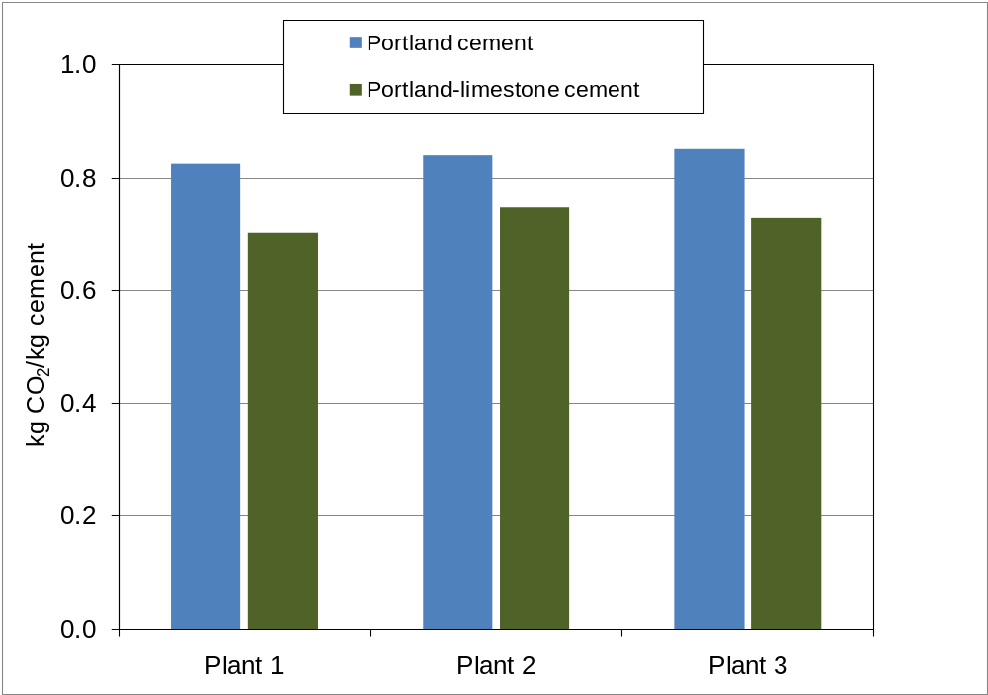
Environmental Benefits - CO2

Slide 8
History of Limestone in Cements
1965 Cement with 20% limestone in Germany for specialty applications
1979 French cement standards allows limestone additions.
1983 CSA A5 allows up to 5% limestone in portland cement
1990 15±5% limestone blended cements routinely used in Germany
1992 UK specs allows up to 20% in limestone cement
2000 EN 197-1 allows 5% MAC (typ. limestone) in all 27 common cements, as was commonly practiced in various European cement standards prior to that.
2000 EN 197-1 creates CEM II/A-L (6-20%) and CEM II/B-L (21-35%)
2004 ASTM C 150 allows 5% in Types I-V
2006 CSA A3001 allows 5% in other Types than GU
2007 AASHTO M85 allows 5% in Types I-V
2008 CSA A3001 includes PLC containing 5%-15% limestone

Slide 9
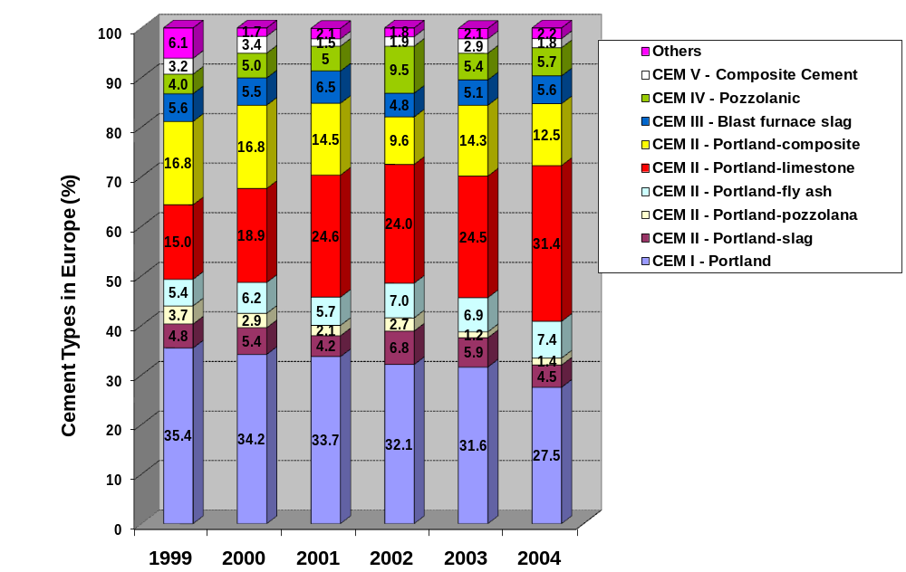
European Cement Use
Cembureau data

Slide 10
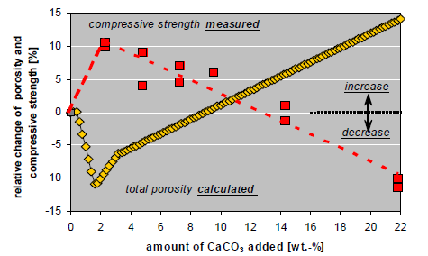
Why 15%?

Slide 11
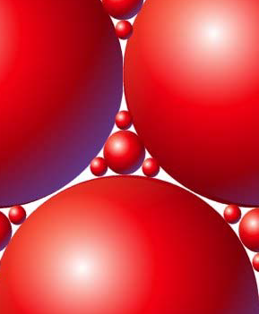
How Limestone Works
Particle packing
  Improved particle size distribution
  The same effect with packing can be had be be had with fly ash.

Slide 12
How Limestone Works
Nucleation
  Surfaces for precipitation
  Any small particle will act
  as nucleation sites.

Slide 13
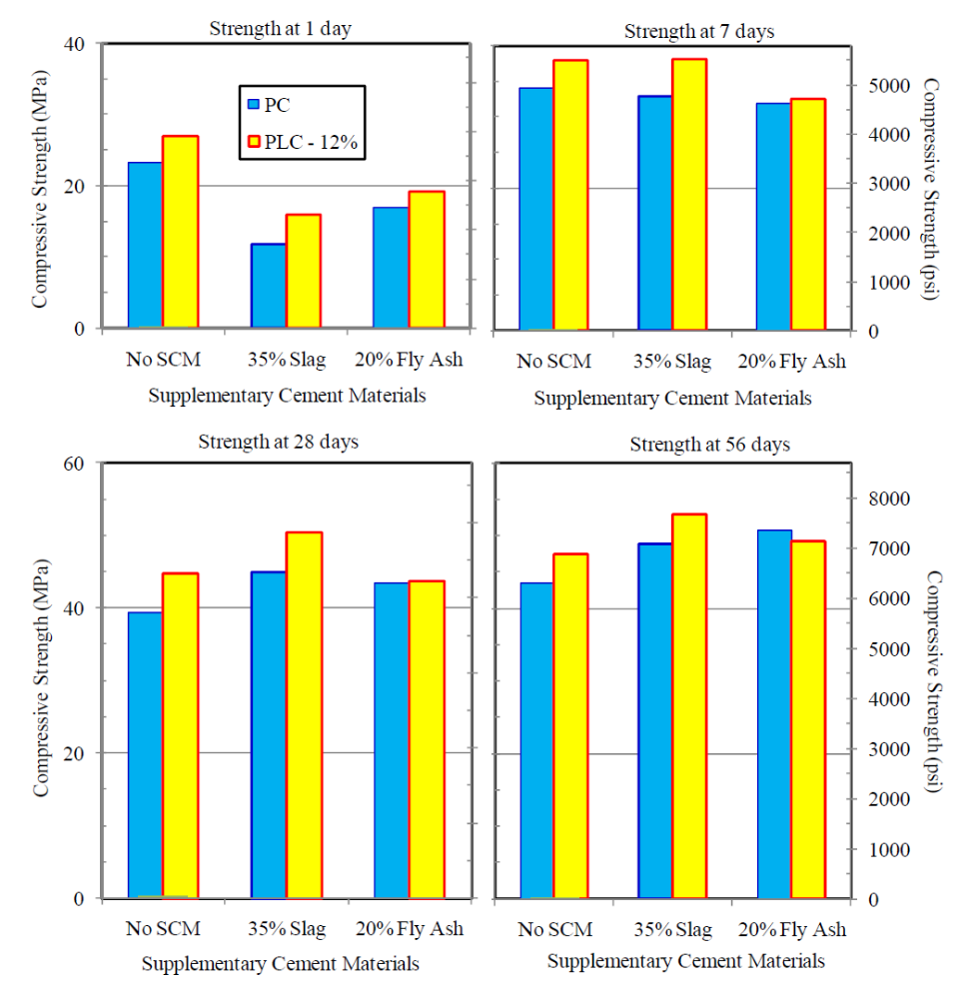
Performance: Strength

Slide 14
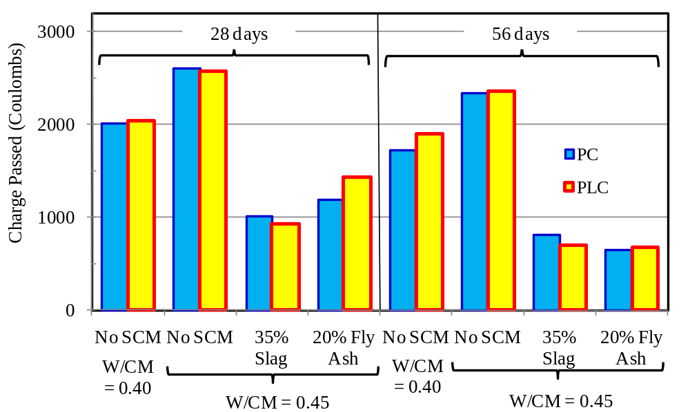
Performance: RCPT T277/C1202 No change

Slide 15
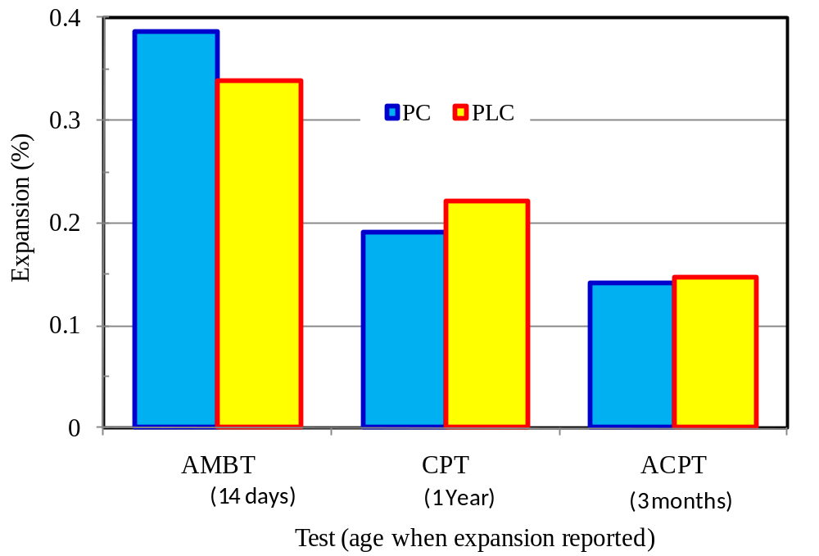
ASR Resistance

Slide 16
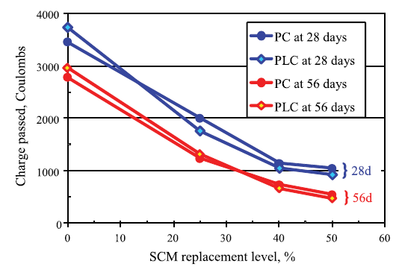
Field Trials – T277/C1202

Slide 17
AASHTO M240 & ASTM C595 Requirements
Type IL—Portland-limestone blended cement
  Example: Type IL(10) = 10% limestone
Type IT—Ternary blended cement with limestone
  Example 1: Type IT(L10)(P10) = 10% limestone and 10% pozzolan
  Example 2: Type IT(S15)(L10) = 15% slag and 10% limestone
Limestone content 5% to 15%

Slide 18
AASHTO M240 & ASTM C595 Requirements
Same physical requirement as existing C595/M240 cement types
Chemical require changes– sulfate content, LOI
Sulfate resistance – no MS or HS in initial ballot
Limestone quality specs – %CaCO₃, MBI, TOC
Not all cement quarries will have limestone that meets the standard.

Slide 19
Requirements for Limestone for Use in Type IL – Cannot add agriculture limestone to Portland cement
 | Test Method | Limit
CaCO₃ content | C114/T105 | Min. 70%
Methylene blue index | See Annex A2 | Max. 1.2 g/100g
Total organic carbon | See Annex A3 | Max.0.5%

Slide 20
Additional Information
  Cement fineness is 480-500. Limestone is more friable than clinker in grinding and particle size is controlled to control set and strength.
  PCA claims that higher fineness does not affect water demand.
  Limestone is inert and does not react.
  Several states have already approved Type IL
  There is no price benefit in using PLC.
  PLC can be available in this area

Slide 21
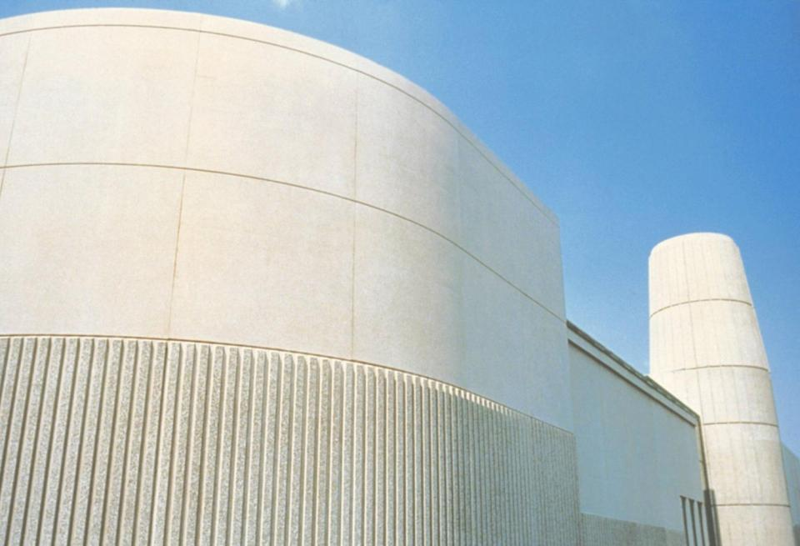
Thank you!

